Slide 1
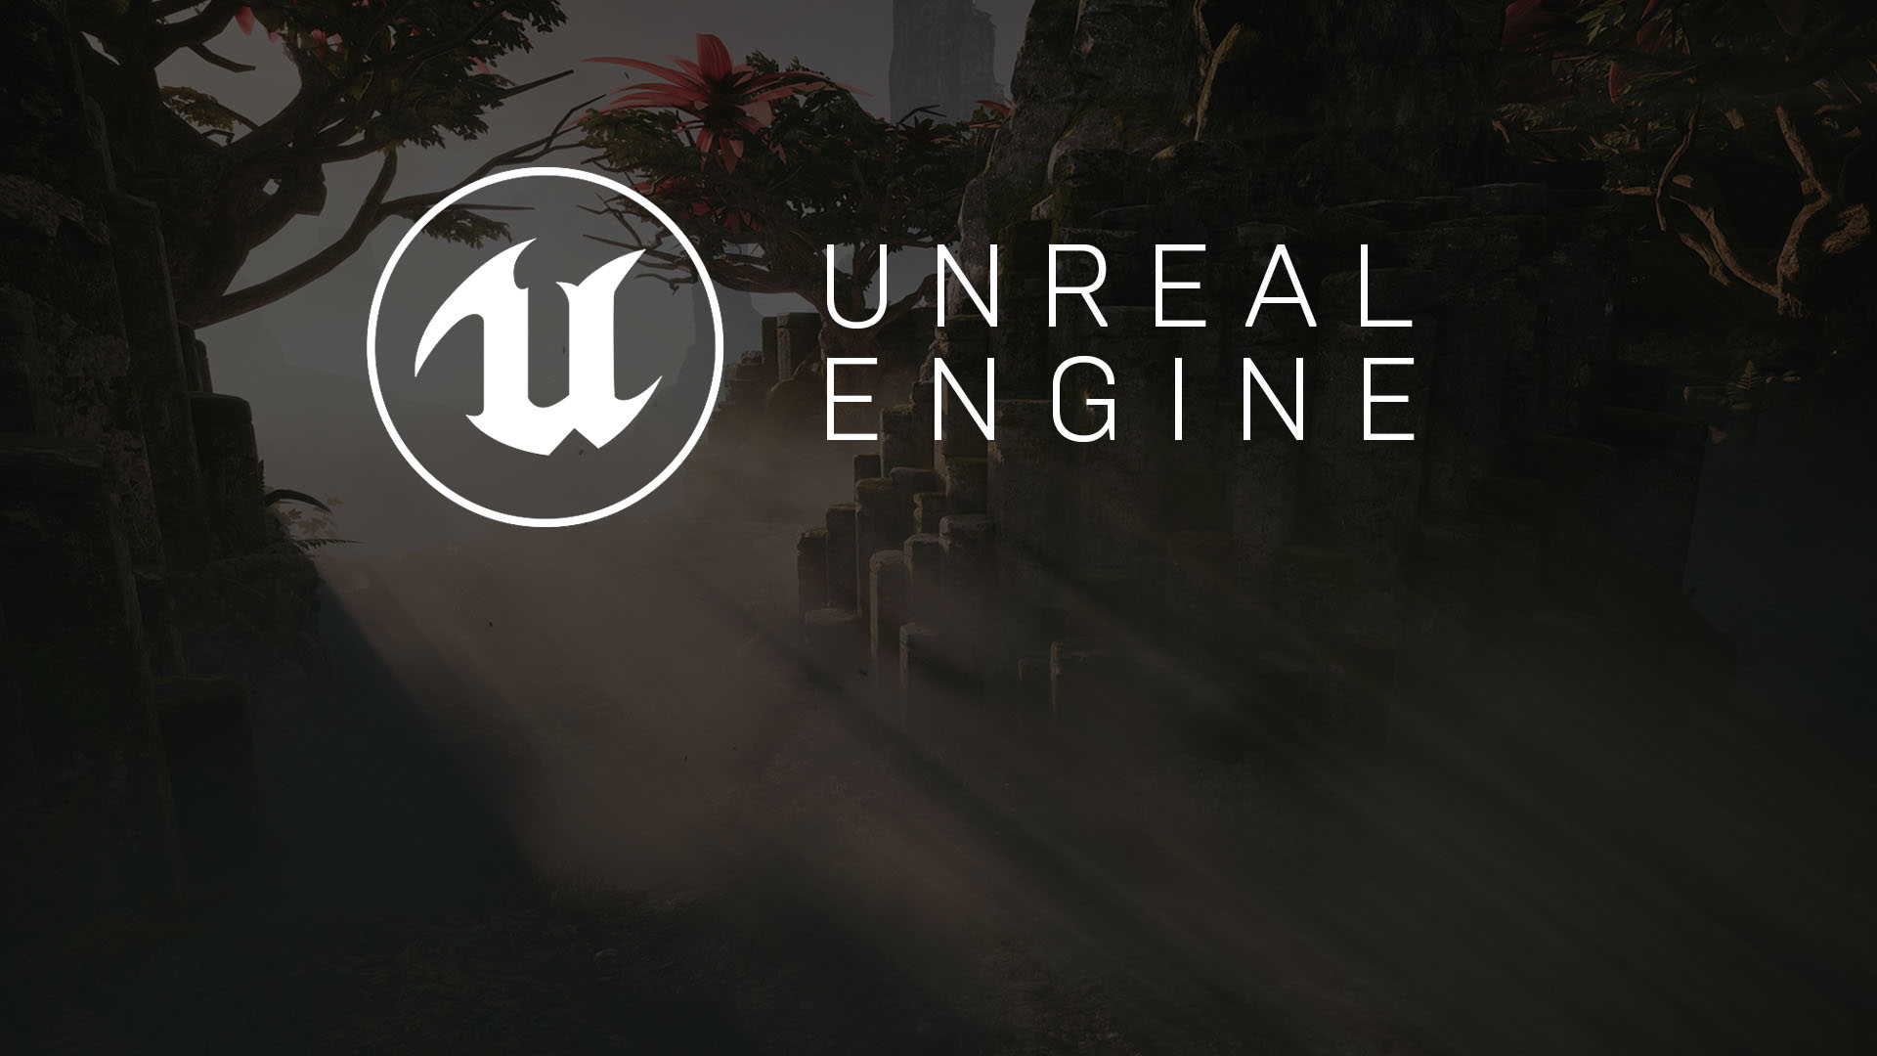
Hour 1
Your First Project:
Learning the UE4 Editor Interface

Slide 2

Introduction
In this lecture, you will create your first project, learn to navigate the Editor interface, and learn to move around a Level in the Editor and playtest the default map.

Slide 3
Lecture Goals and Outcomes
Goals
Outcomes
The goals of this lecture are to
Learn to create a new project
Learn the Level Editor interface
Learn how to navigate a Level in the Viewport
Learn to playtest a Level
By the end of this lecture you will be able to
Create a new project
Understand the Level Editor interface
Navigate a Level in the Viewport
Playtest a Level

Slide 4
Creating a New Project
Level Editor
Notes:
VR exists through the melding of hardware and software. There are various devices and software solutions you need to be aware of when getting into creating VR content.

Slide 5
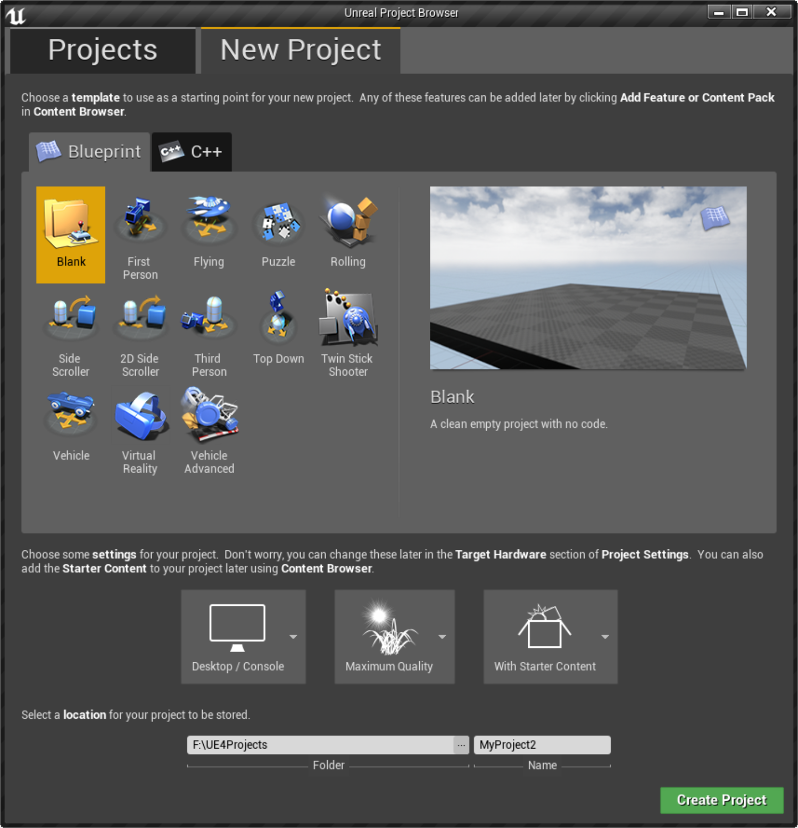
Project Browser
When you launch UE4, it opens the Project Browser.
The Projects tab shows you all the projects you are currently working on.
The New Project tab is used for creating new projects based on existing common Game Mode templates.
Notes:
If you have never scripted before or if you have scripted but have never used UE4 before, it is a good idea to become familiar with the Editor and workflow before you move to a C++-based project.

Slide 6
New Project Tab
From the Project Browser, you can create a Blueprint-based project or a C++-based project.
Blueprint is the visual scripting environment used to script functionality for a game project.
C++-based projects allow users to program functionality in the traditional manner of writing code.
Notes:
A C++-based project requires you to install a compiler, such as Visual Studio 2015. Even with a C++-based project, you will be using Blueprint to some degree.

Slide 7
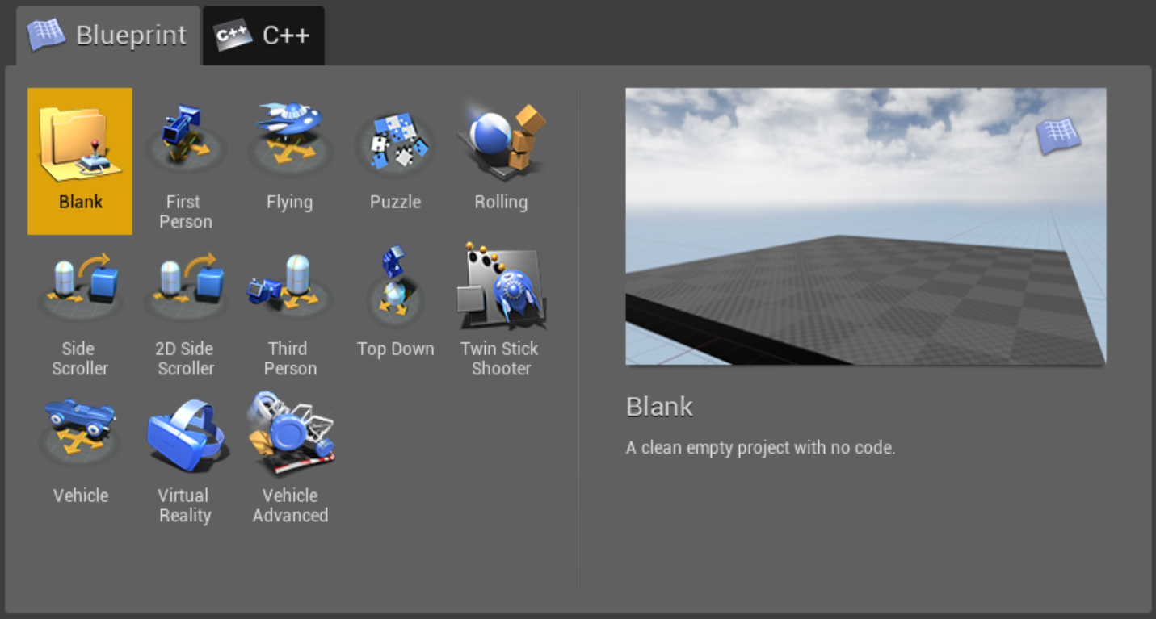
Game Mode Templates
Game Mode templates are common game types built around the Gameplay Framework. There are templates for both Blueprint- and C++-based projects.
Notes:
When projects are first created, they are not very large, but project file sizes grow rapidly depending on the amount of content and the quality of content, such as model details and Texture sizes. UE4 also generates autosave and backup files as you work; although these files take up space, they are helpful when anything goes wrong.

Slide 8
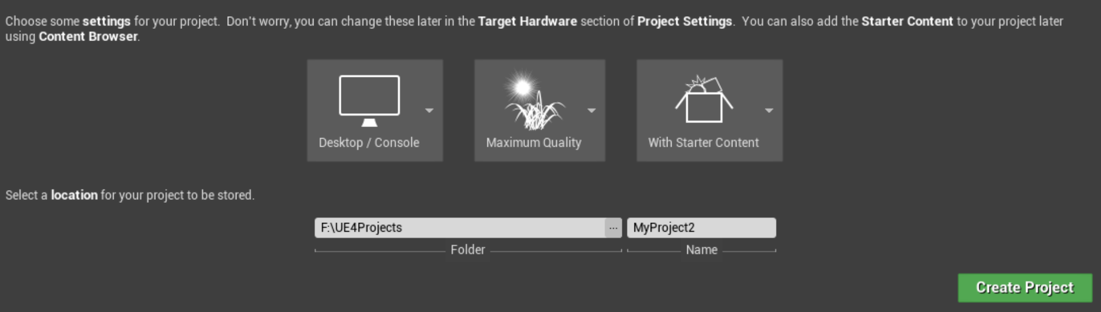
Project Settings
The Project Settings tab allows you to select base project settings, such as target hardware and graphics quality, and to include some basic assets to work with.
Target hardware: You can choose either Desktop/Console or Mobile/Tablet.
Target graphics: You can choose between Maximum Quality and Scalable 3D or 2D. These options change the project’s default settings for content development.
Starter content: You can add basic assets to your project to work with.
Notes:
These settings can be changed later under Project Settings.

Slide 9
Saving your Project
Once you have made your desired selections, you need to name your project.
Ensure the folder you choose is on a drive with ample storage space.
Press Create Project to save your project to the hard drive.
Note: Project locations can be changed by closing the Editor, moving the project folder, and then relaunching the Editor and opening the project from its new location.
Target hardware: You can choose either Desktop/Console or Mobile/Tablet.
Target graphics: You can choose between Maximum Quality and Scalable 3D or 2D. These options change the project’s default settings for content development.
Starter content: You can add basic assets to your project to work with.
Notes:
It is best to work off the local hard drive. While working over the school network or off of a USB drive will work, reduced bandwidth may slow down some Editor processes such as auto backups.
If assets are missing from the Content Browser, it may be due to reduced bandwidth.

Slide 10
Creating a New Project
In the Launcher, click Launch.
1
Select the New Project tab.
2
Select the Blueprint tab.
3
Choose a Game Mode template.
4
Select target hardware.
5
Pick target graphics quality.
6
Decide if you want starter content.
7
Pick a location on your HDD.
8
Give the project a name.
9
Finally, click Create Project.
10
Process for creating a new Level

Slide 11
Exercise: Create a New Project
Create a new Blueprint project using the following:
Third Person template
Desktop/Console
Maximum Quality
With Starter Content

Slide 12
Main Interface
Level Editor

Slide 13
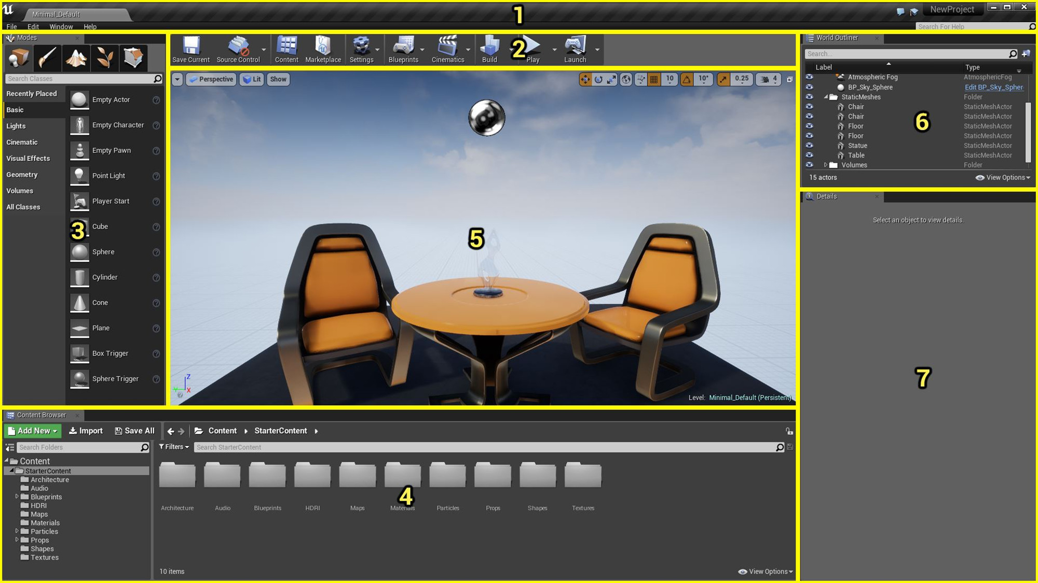
Unreal engine 4 Editor interface
The main UE4 Editor interface, referred to as the Level Editor, is primarily used for world and Level building and for asset placement.
Menu bar
Level Editor toolbar
Modes panel
Content Browser panel
Viewport panel
World Outliner panel
Details panel
Unreal Engine 4 Editor interface
Notes:
Menu bar
Level Editor toolbar
Modes panel
Content Browser panel
Viewport panel
World Outliner panel
Details panel
The Editor interface layout is modifiable. You can easily reposition panes and windows to improve workflow. In these lectures, all interface elements are left in their default locations for consistency, but as you become a more experienced user, you will most likely want to reposition elements to increase productivity.

Slide 14
1. Menu Bar
The menu bar consists of File, Edit, Window, and Help menus.
File contains operations for loading and saving projects and Levels.
Edit has your standard copy and paste operations, as well as Editor preferences and project settings.
Window opens Viewports and other panels.
Help contains links to external resources, such as online documentation and tutorials.
Unreal Engine 4 Editor interface
Notes:
If you ever close a window or panel, you can go to the Window menu to open it again.

Slide 15
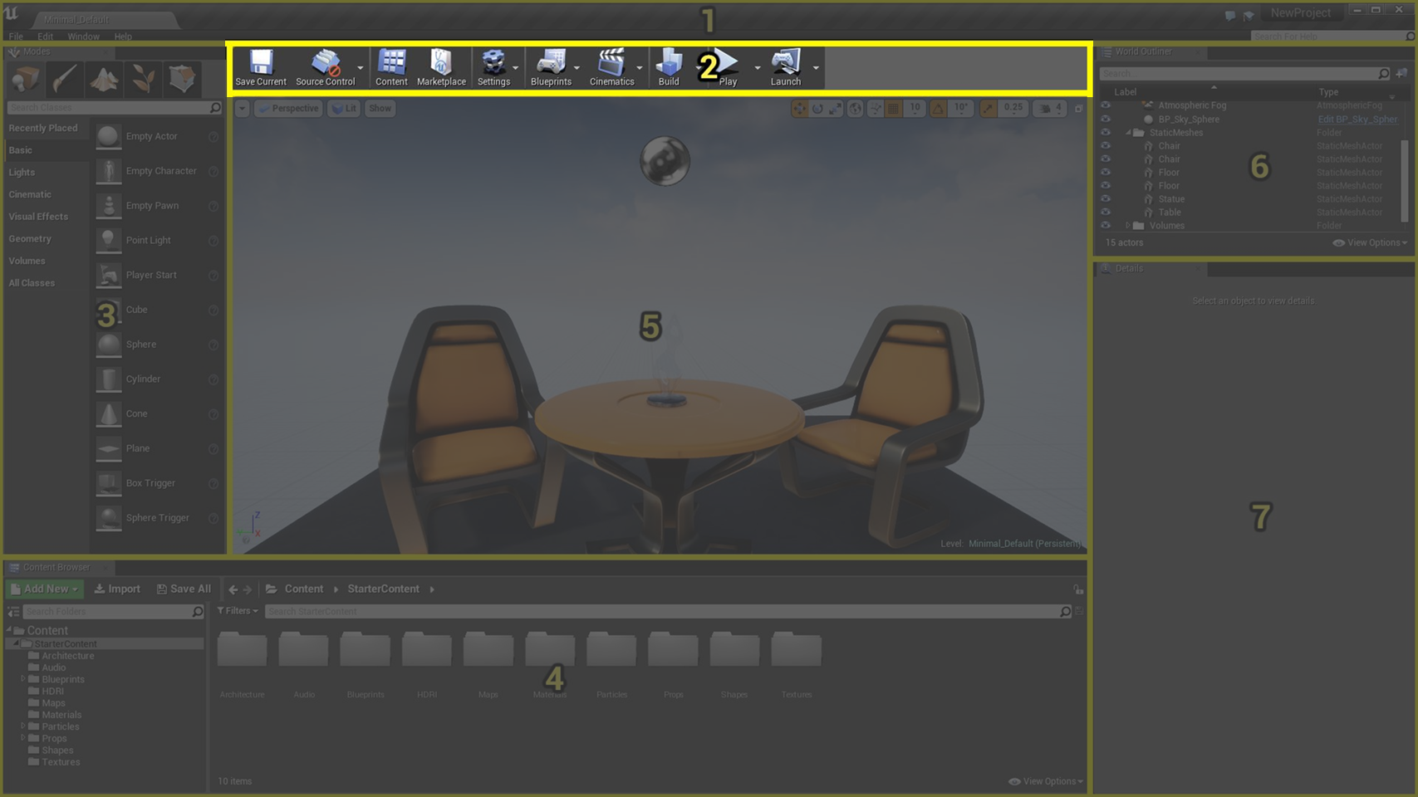
2. Toolbar
The Level Editor toolbar provides quick access to commonly used tools and operations, such as
Saving the current Level
Building precalculated lighting for static Actors
Changing Editor display properties
Playtesting the current Level
Unreal Engine 4 Editor interface

Slide 16
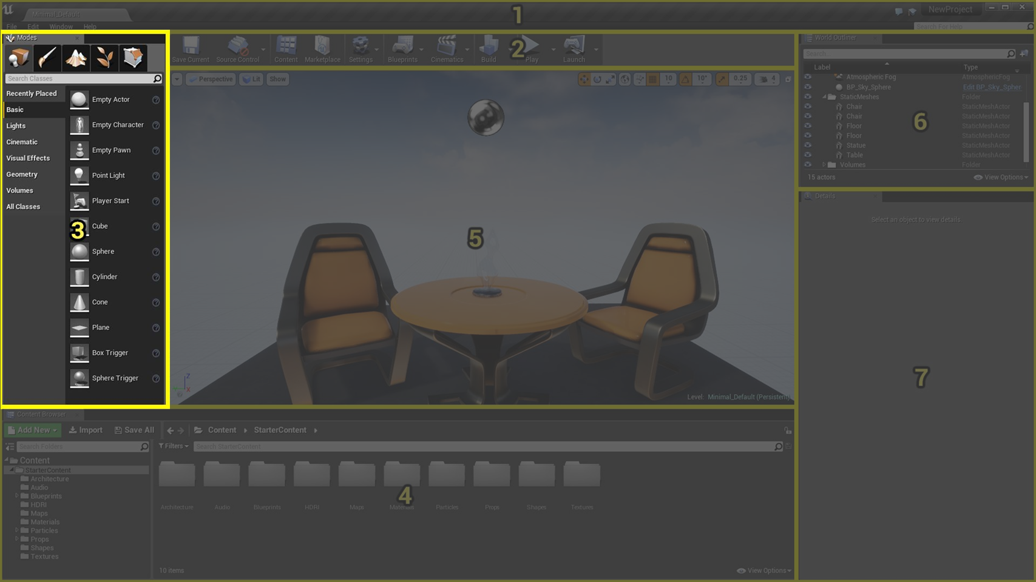
3. Modes Panel
The Modes panel displays the various editing modes. It allows for specific editing interfaces for working with different types of Actors.
Unreal Engine 4 Editor interface

Slide 17
Place mode
Contains default classes that can be placed in a Level as Actors (for example, Point Light class, Static Mesh class, Box Trigger class).
Paint mode
Used for painting vertex color data on Static Mesh Actors.
Landscape mode
Used for creating and editing Landscape Terrain Actors.
Foliage mode
Used for painting instanced Foliage Actors in a Level.
Geometry Editing mode
Used for editing BSP Brush Actors on the vertex edge face Level.
Modes Panel
The Modes panel allows you to change the current focus of the Editor. You can select a specialized task, such as
Placing new Actors in a Level
Painting vertex color data on meshes
Creating and editing Landscapes
Applying foliage to a Level
Creating BSP brushes and volumes

Slide 18
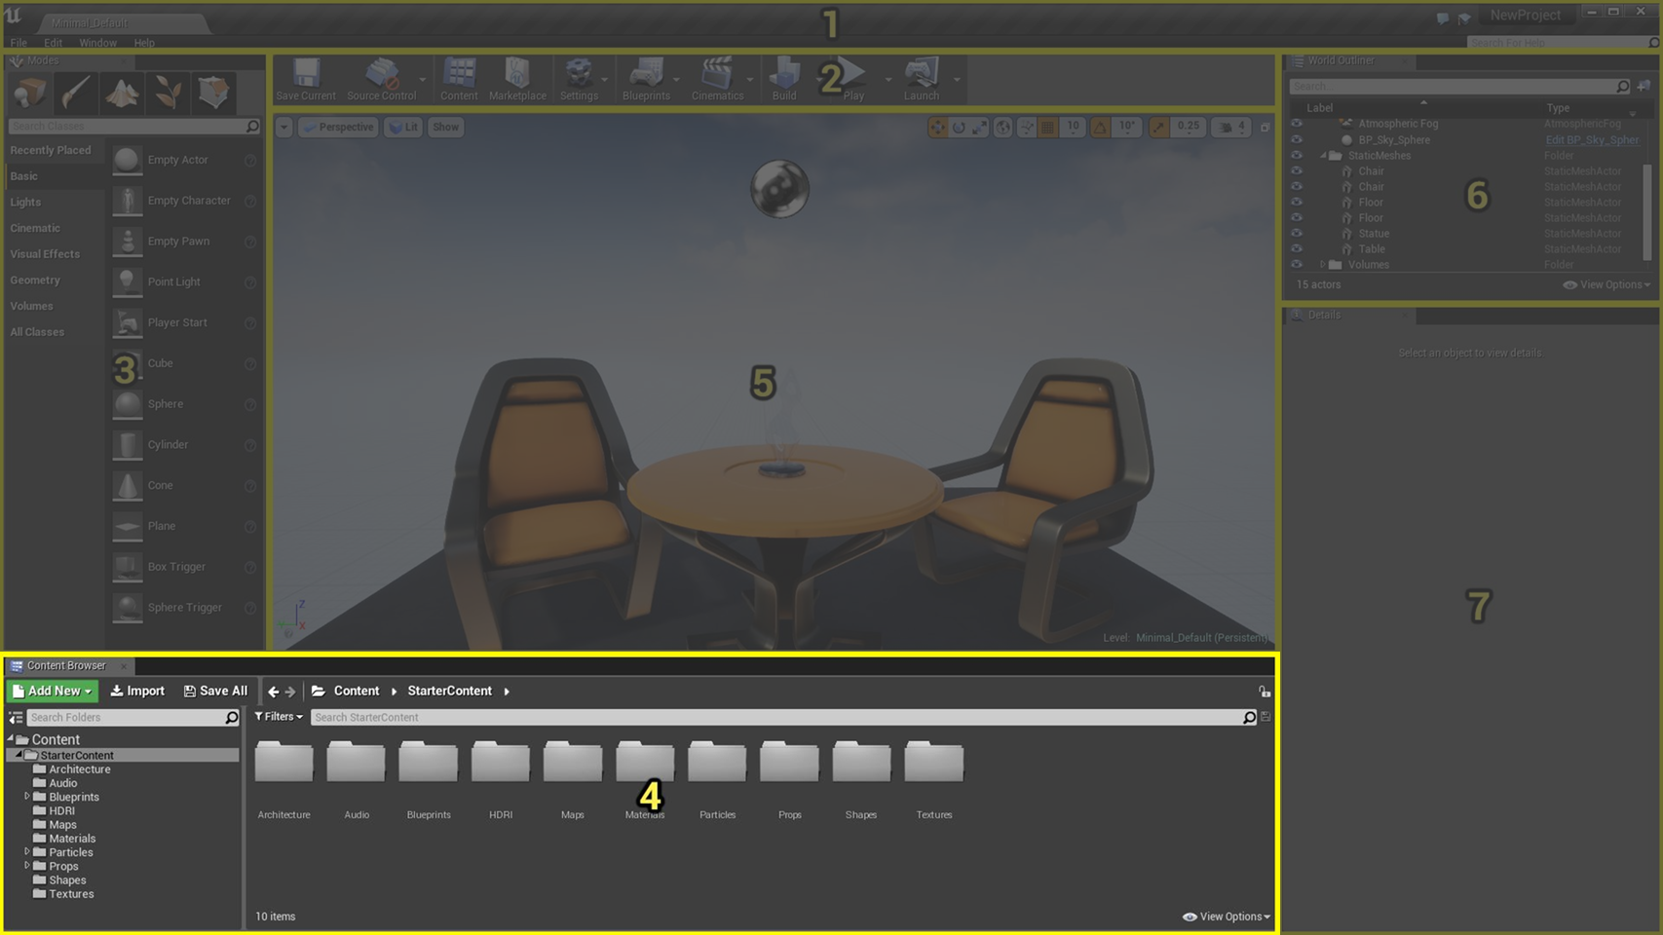
4. Content Browser
The Content Browser is the primary area for creating, importing, organizing, viewing, and modifying content assets within the Unreal Editor.
It also provides the ability to manage content folders and perform other useful operations on assets, such as renaming, moving, copying, and viewing references.
The Content Browser can search for and interact with all assets in the game.
Note: Once an asset is placed in a Level, it’s referred to as an Actor.
Unreal Engine 4 Editor interface

Slide 19
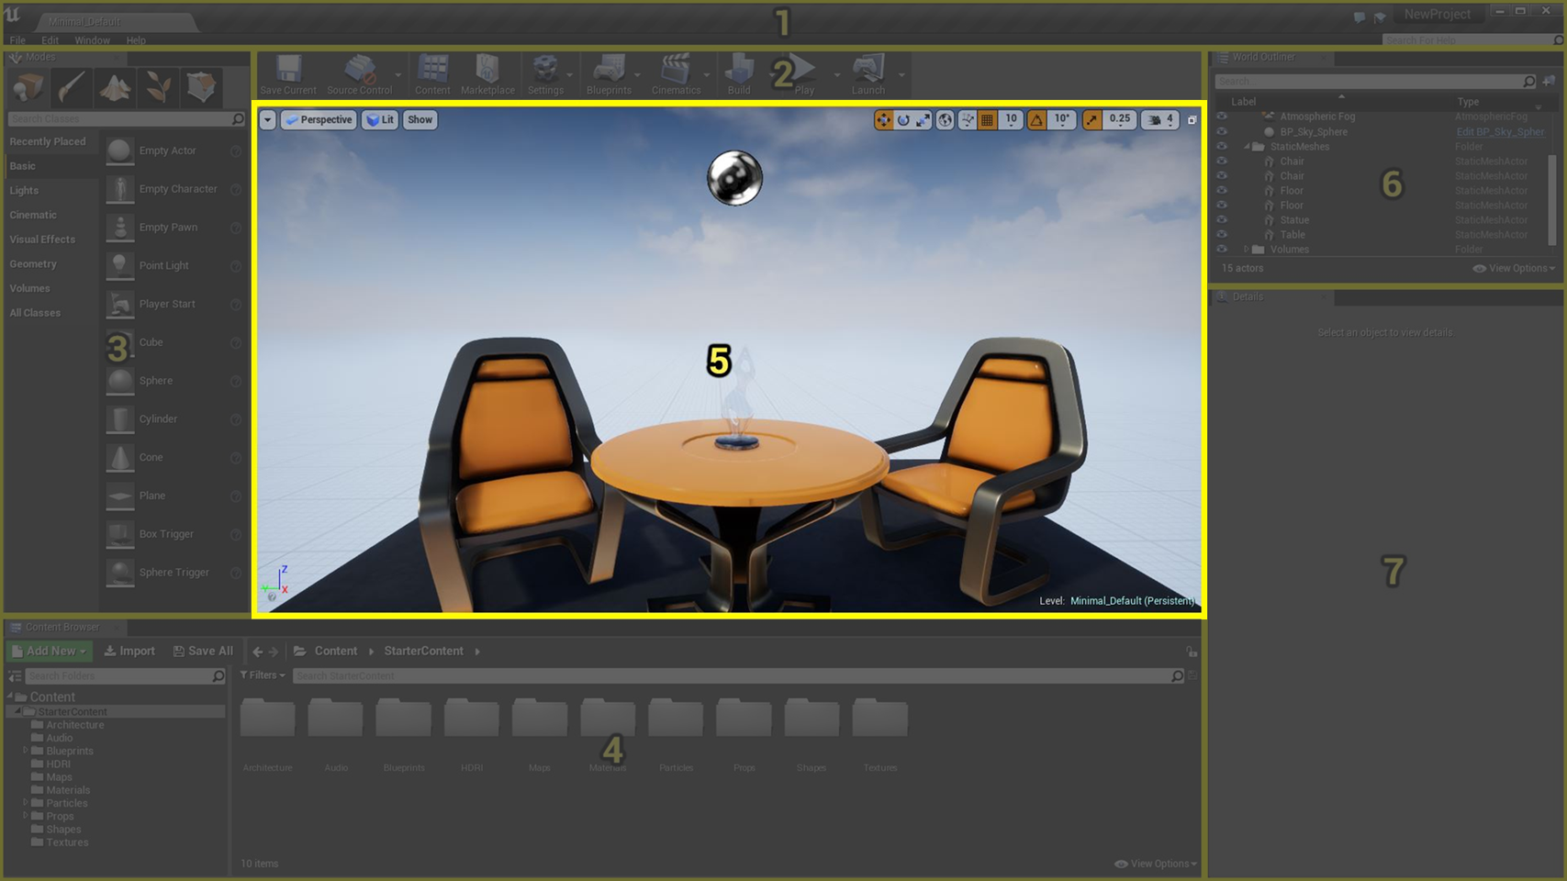
5. Viewports
The Viewports are your window into the worlds you create in Unreal. They can be navigated just as you would in a game, or they can be used in a more schematic design sense, as you would for an architectural blueprint.
The Unreal Editor Viewports contain a variety of tools and visualizers to help you see exactly the data you need.
Unreal Engine 4 Editor interface
Notes:
The Viewport is the main panel used for set dressing and world building. The Viewport panel has many different modes, layouts, and settings, all of which help you create, edit, and manage your Levels.

Slide 20
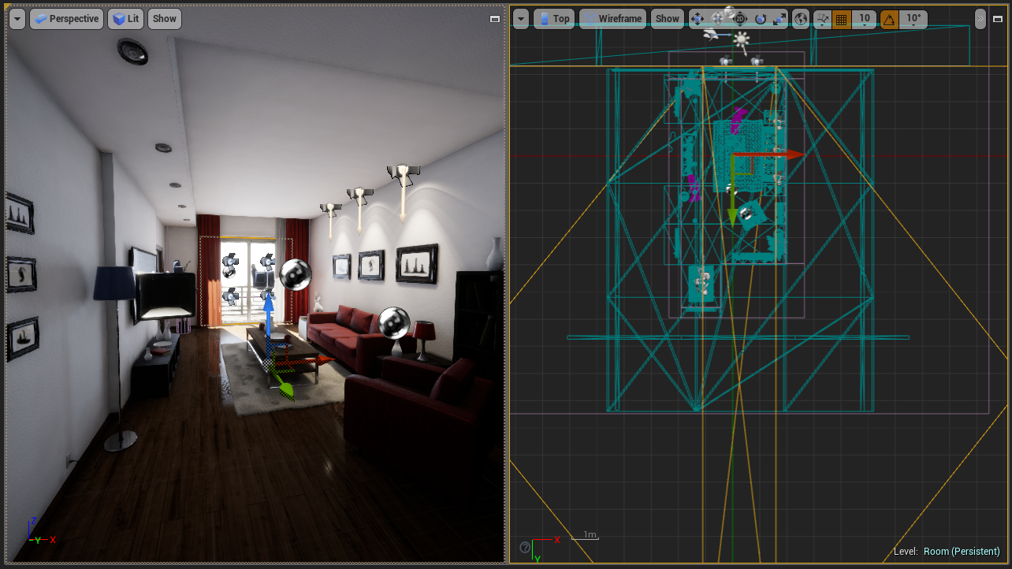
Perspective
Orthographic
Perspective Viewports
Orthographic Viewports
Perspective Viewports display the world in 3D with vanishing points.
Orthographic Viewports show the world in a 2D schematic view.
Notes:
The perspective view will most likely be your primary working environment, but orthographic views are great for fine-tuning Actor placement in a scene.

Slide 21
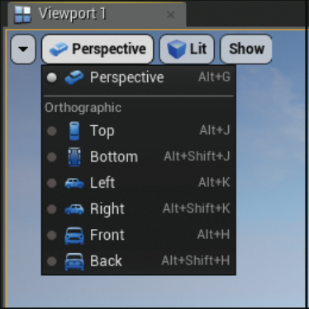
Viewport Types
There are seven standard Viewport types: one perspective and six orthographic.
Perspective (Alt+G)
Top (Alt+J)
Bottom (Alt+Shift+J)
Left (Alt+K)
Right (Alt+Shift+K)
Front (Alt+H)
Back (Alt+Shift+H)

Slide 22
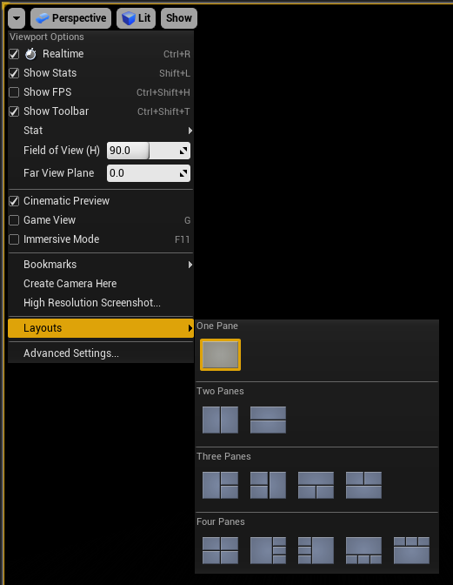
Viewport Layout
By default, the Viewport panel displays a single-pane perspective view.
You can easily change it to a two-, three-, or four-pane layout by clicking the Viewport drop-down menu, selecting Layouts, and left-clicking on the desired format.
Note: You can change each pane in the Viewport panel to a different view mode at any time.

Slide 23
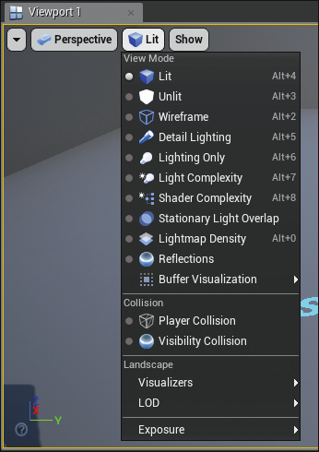
View Modes
View modes change the visual display of the Level in a Viewport.
More than 13 different view modes, along with other visualization tools, are available. You can use them to get feedback on a Level and to debug and troubleshoot many potential issues.

Slide 24
Lit
Unlit
Wireframe
Lighting Only
Detail Lighting
View Modes
View modes and visualizers can provide important feedback on the state of a Level.

Slide 25
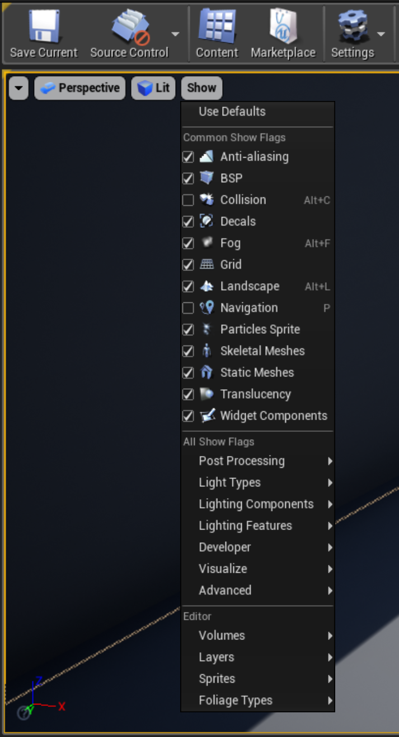
Show Flags
Like view modes, show flags help display relevant information directly within the Level Viewport. For example, they can be used to display
Actor collision hulls
Bounding boxes
Static Meshes

Slide 26
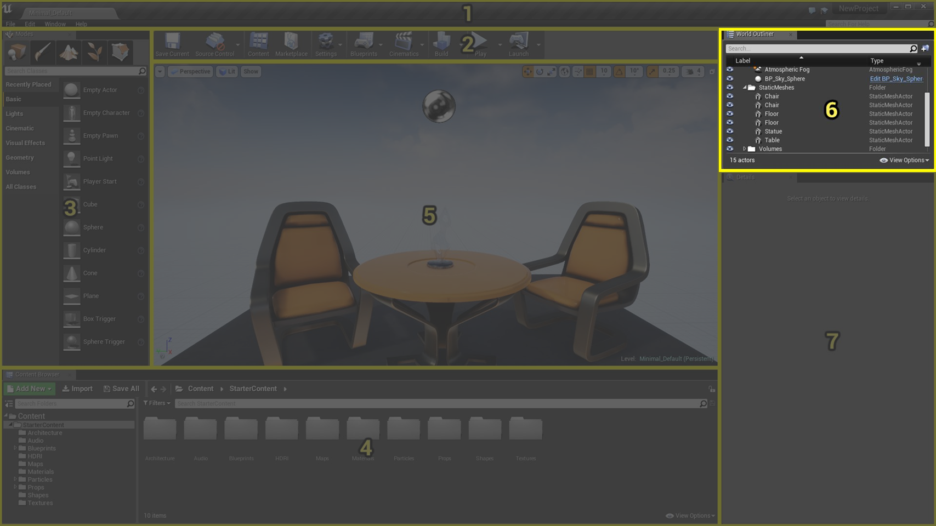
6. World Outliner
The World Outliner panel displays all the Actors within the current Level in a hierarchical tree view.
You can select an Actor simply by clicking its name in the World Outliner panel. The selected Actor’s properties will show up in the Details panel (7).
Unreal Engine 4 Editor interface
Notes:
Double-clicking on an Actor’s name will focus the Viewport panel on the placed Actor in the Level.

Slide 27
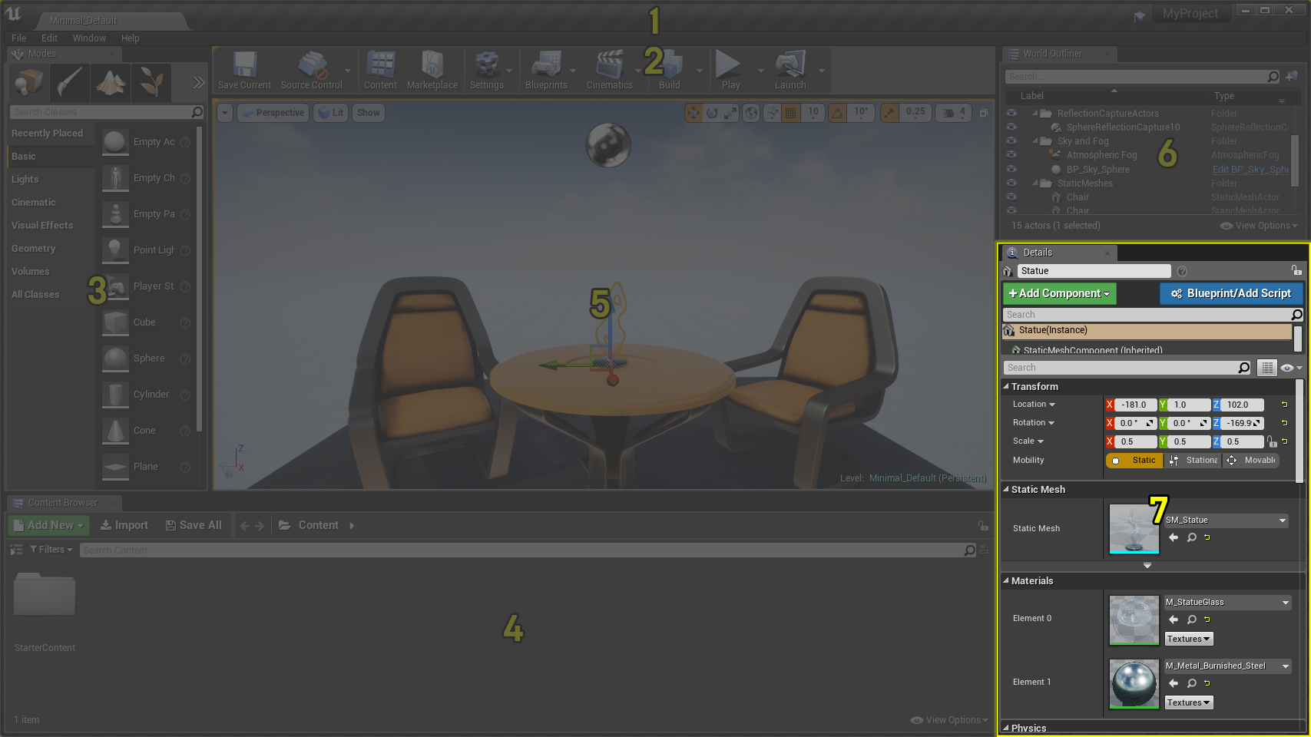
7. Details Panel
The Details panel displays all the editable properties for a selected Actor.
Common properties include
The name of the Actor
Transform edit boxes for moving, rotating, and scaling the Actor
Rendering display properties
Some properties that appear depend on the class of Actor currently selected.
Unreal Engine 4 Editor interface

Slide 28
Navigating a Scene
Viewport Navigation

Slide 29
Navigating a Scene in the Perspective Viewport
Unlike in other 3D applications, which are set up for focusing and orbiting around a single asset as it’s being built, the Unreal Engine Viewport movement controls are designed for set-dressing large game Levels, where moving through large areas quickly is key.
Control | Action
Left-click+drag | Moves the Viewport camera forward and backward and rotates left and right.
Right-click+drag | Rotates the Viewport camera in place without forward or backward movement.
Left-click+right-click+drag | Moves the Viewport camera up and down in the world.
Ctrl+Alt+click+drag | Creates a marquee selection box.
Hold RMB+WASD keys | Moves you through the Level as you would in a typical first-person shooter.

Slide 30
Orbiting, Dolly, and Track Viewport Controls
You can still work with Actors the same way as you do in traditional 3D applications.
Control | Action
F key | Focuses the Viewport camera on the selected Actor in the Viewport.
Alt+LMB+drag | Tumbles the Viewport around a single pivot or point of interest.
Alt+RMB+drag | Dollies (zooms) the camera toward and away from a single pivot or point of interest.
Alt+middle-click+drag | Tracks the camera left, right, up, and down in the direction of mouse movement.

Slide 31
Playtesting a Level
Play in Editor (PIE)

Slide 32

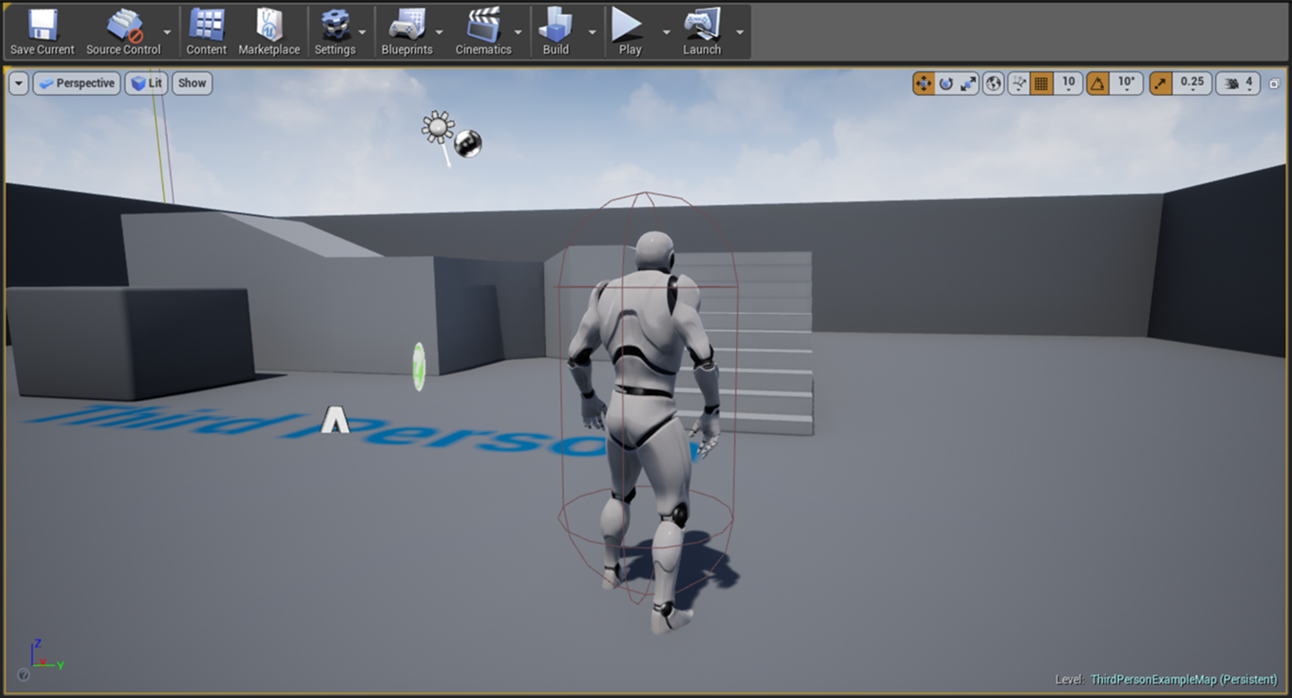
Playing a Level
When you create a project, a default Level is already made for you. Playtesting a Level involves using the input system your players will use when interacting with your game as defined by the Game Mode template you selected.

Slide 33
Play in Editor (PIE)
Play in Editor (PIE) refers to a collection of options that allows you to playtest a Level without having to compile or package content beforehand.
The PIE preview options are found on the Level Editor toolbar, under the Play button.
Unreal Engine 4 Editor interface

Slide 34
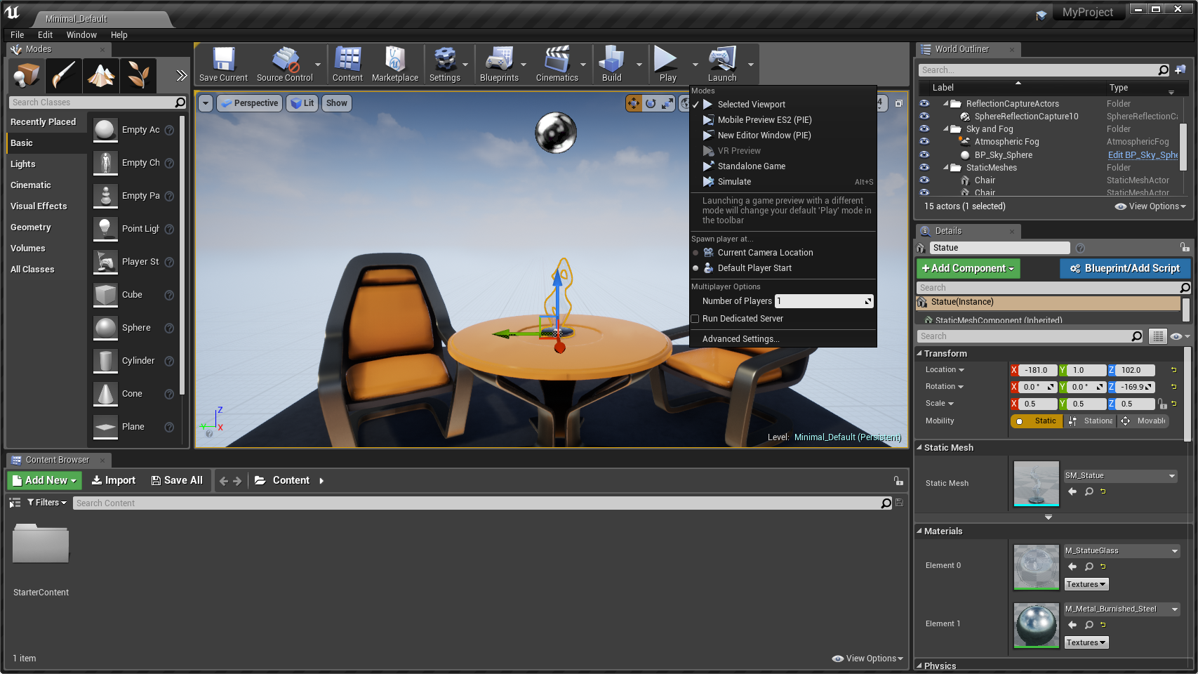
Play in Editor (PIE)
There are a few different ways to playtest a Level. You can click the Play icon to play your Level or click the drop-down arrow to the right of the Play icon and choose one of the Play modes.
By default, UE4 uses the Selected Viewport option.
Play in Editor menu

Slide 35
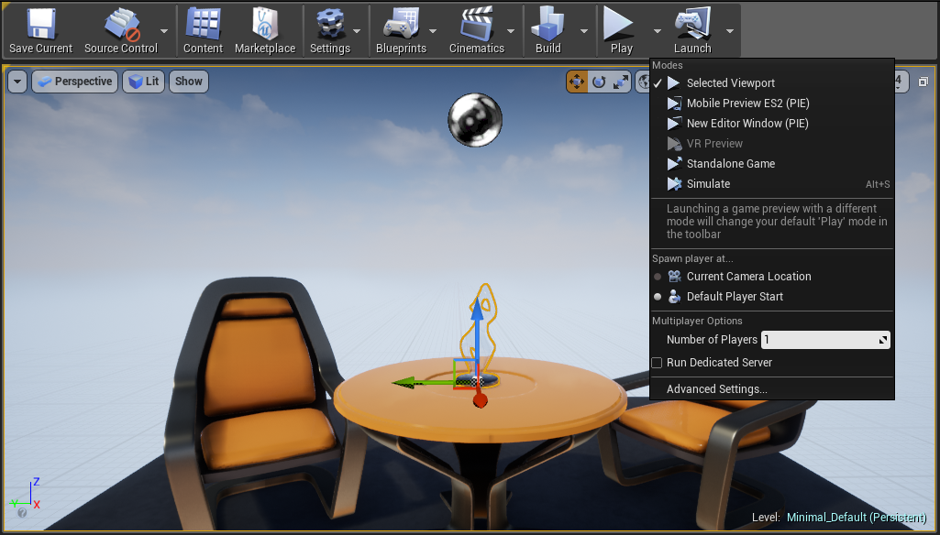
New Editor Window (PIE)
The New Editor Window option changes the preview play icon and launches a preview of the Level in a new window.
Play in Editor menu

Slide 36
Advanced Settings
At some point, you may need to preview the Level in the resolution or aspect ratio of the target platform.
Play in Editor menu

Slide 37
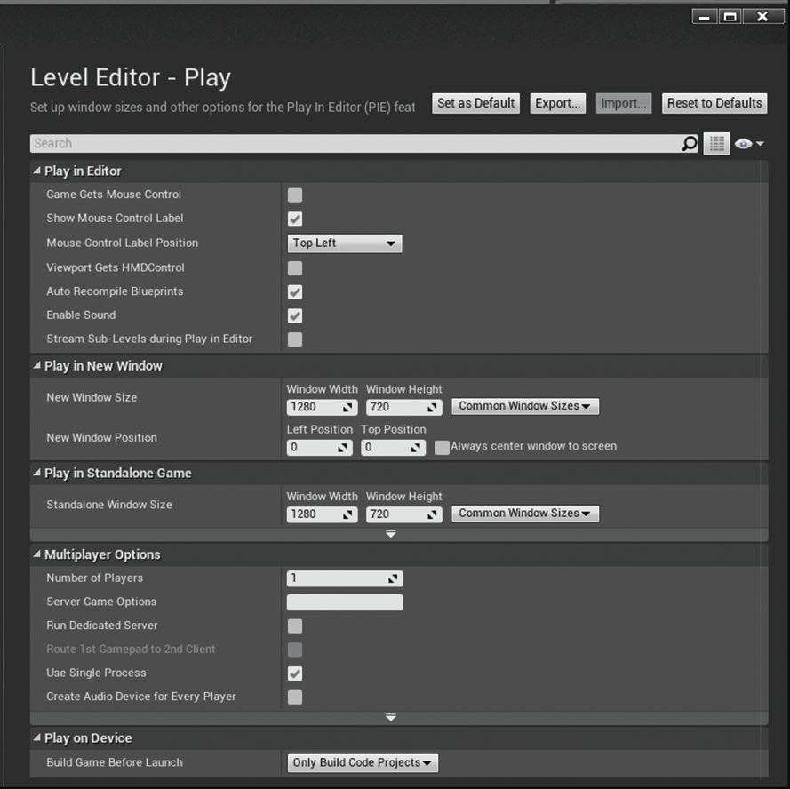
Advanced Play in Editor Settings

Slide 38
Exercise: Use Play in Editor (PIE)
Playtest the default map of the Third Person Game Mode template.
Playtest the Level in Selected Viewport mode.
Change to playtest the Level in New Editor Window (PIE) mode.
Use Advanced Settings to change the resolution.

